Slide 1
Role Object pattern
mahfuzul haque

Slide 2
intent
The role object pattern is a model that allows for a class (core object) to play multiple roles (role objects) concurrently of which are dynamically attached and removed from the core object. A role in this regard is a purpose that a class serves given a certain context.
Different contexts can be kept separate by representing roles as individual objects.
This pattern simplifies the process of having objects that can assume more than one role.
Each individual object manages its own role.

Slide 3
motivation
Suppose a scenario where you have an employee that works at a retail store.
An employee in this case can work multiple positions (roles) such as sales representative and inventory stocking.
To model this scenario in a program which might manage such employees, it would not make sense to use inheritance because although you can have a parent class employee and child class sales representative or child class inventory stocker, they would be separate objects. They cannot be one and the same. The role object pattern addresses this issue by having one object which can function as both a sales representative and inventory stocker.

Slide 4
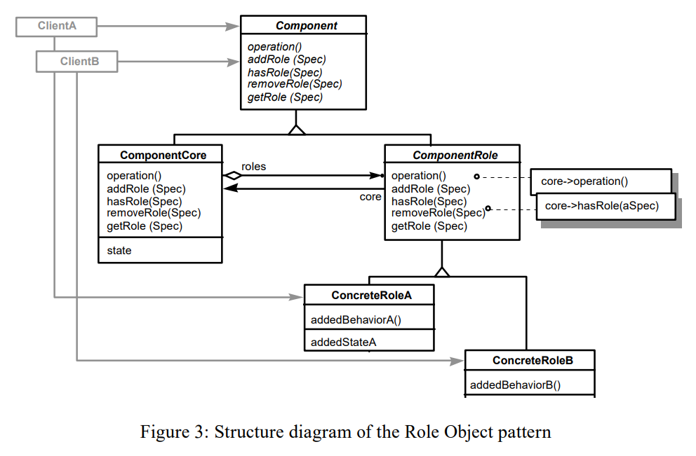
Structure

Slide 5
Advantages
The role objects can be changed easily and independently of one another.
Role objects can be added and removed from a core object dynamically
Applications are decoupled better

Slide 6
consequences
Clients will likely get more complex through time. This is because as more roles get added to the core, the process of checking whether the object plays a certain role becomes resource intensive.
Due to the increasing number of roles attached to a core, this also causes a problem of maintaining constraints and preserving consistency between the roles since they are mutually dependent.
Since role objects are mutually dependent in this pattern, it isn’t possible to have a role object that depends on another role object, which is a very common scenario in certain environments. This can be problematic.

Slide 7
Known uses
GEBOS banking project makes use of this pattern.
The IT research lab of Union Bank of Switzerland is also using the role object pattern in its projects
The most broad and generic use of this pattern is to illustrate a relationship between a person and its roles

Slide 8
References
Role Object Pattern - Dirk Bäumer, Dirk Riehle, Wolf Siberski, and Martina Wulf

Slide 9
DEMO

